Slide 1


Matplotlib: Visualization with Python
AFRICA DATA SCHOOL
www.africadataschool.com

Slide 2
Matplotlib is a comprehensive library for creating static, animated, and interactive visualizations in Python.
©2021 Proprietary and Confidential. All Rights Reserved.
2

Slide 3
Installation
Anaconda
Conda-forge
Pip
conda install matplotlib
conda install -c conda-forge matplotlib
python -m pip install -U matplotlib
©2021 Proprietary and Confidential. All Rights Reserved.
3

Slide 4
Basics of Matplotlib
Matplotlib graphs your data on Figures.
Each of which can contain one or more Axes.
To create a figure with axes we use pyplot.subplots.
Use Axes.plot to draw some data on the axes.
©2021 Proprietary and Confidential. All Rights Reserved.
4

Slide 5
Loading libraries
# import matplotlib library
import matplotlib.pyplot as plt
%matplotlib inline
Alternatively
import matplotlib
matplotlib.use('qt5agg')
©2021 Proprietary and Confidential. All Rights Reserved.
5

Slide 6
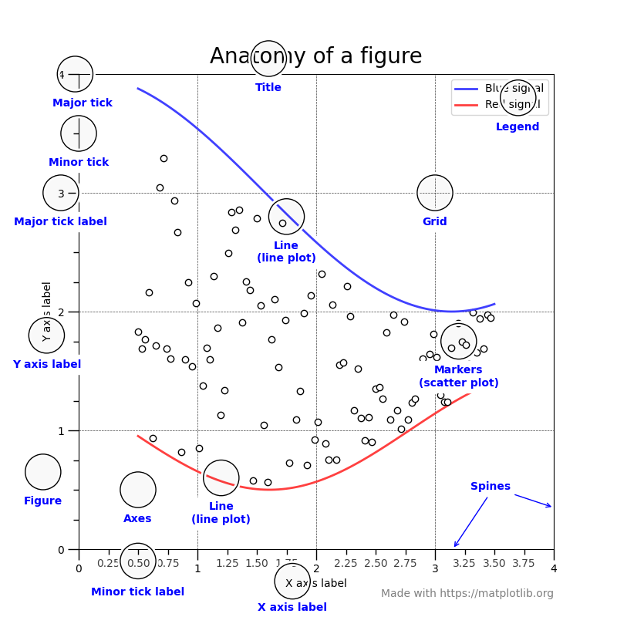
Anatomy of a figure.
©2021 Proprietary and Confidential. All Rights Reserved.
6

Slide 7
Matplotlib figure
Figure
Axis
A canvas which contains .
Whole figure which may contain one or more than one axes (plots)
Number line like objects that take care of generating the graph limits.
Axes
Artist
What we generally think of as a plot.
Each Axes has a title, an x-label and a y-label.
Everything which one can see on the figure is an artist like Text objects, Line2D objects, collection objects.
©2021 Proprietary and Confidential. All Rights Reserved.
7

Slide 8
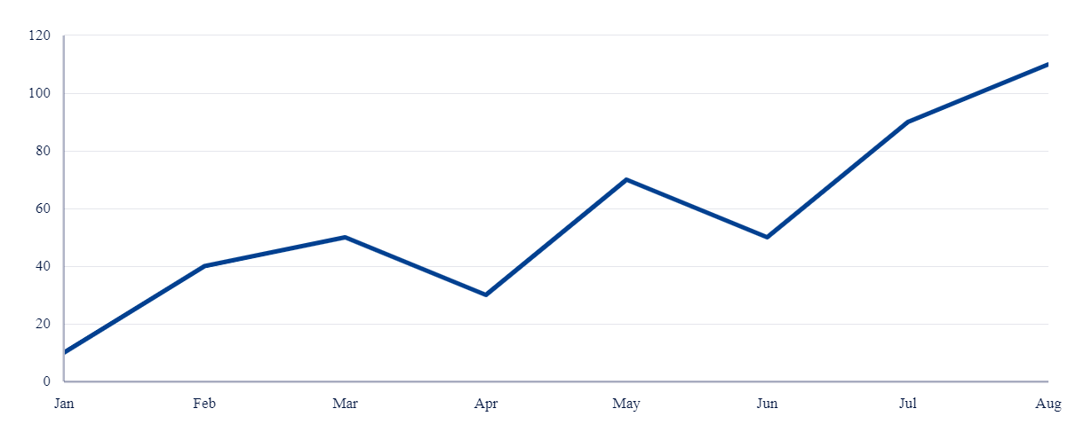
Simple graph
©2021 Proprietary and Confidential. All Rights Reserved.
8

Slide 9
Note
A given figure can contain many Axes, but a given Axes object can only be in one Figure.
The Axes contains two (or three in the case of 3D) Axis objects
Axes has a title (set via set_title()), an x-label (set via set_xlabel()), and a y-label set via set_ylabel()).
©2021 Proprietary and Confidential. All Rights Reserved.
9

Slide 10
Object-oriented and pyplot interfaces

Slide 11
OO-style
Explicitly create figures and axes, and call methods on them (the “object-oriented (OO) style”).
Rely on pyplot to automatically create and manage the figures and axes, and use pyplot functions for plotting
©2021 Proprietary and Confidential. All Rights Reserved.
11

Slide 12
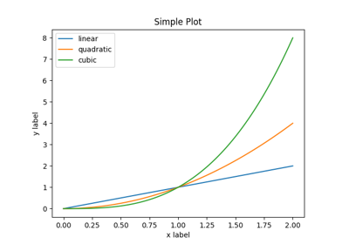
Simple plot
©2021 Proprietary and Confidential. All Rights Reserved.
12

Slide 13
MATPLOTLIB RECOMMENDATION
In general, we suggest to restrict pyplot to interactive plotting (Jupyter notebook), and to prefer the OO-style for non-interactive plotting (in functions and scripts that are intended to be reused as part of a larger project).
©2021 Proprietary and Confidential. All Rights Reserved.
13

Slide 14
pyplot
Each pyplot function makes some change to a figure. e.g,
Creates a figure.
Creates a plotting area in a figure.
Plots some lines in a plotting area.
Decorates the plot with labels, etc
©2021 Proprietary and Confidential. All Rights Reserved.
14

Slide 15
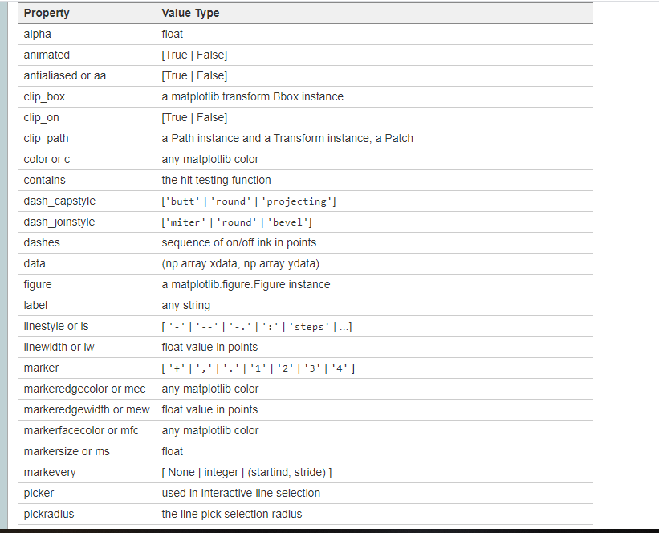
pyplot properties
©2021 Proprietary and Confidential. All Rights Reserved.
15

Slide 16
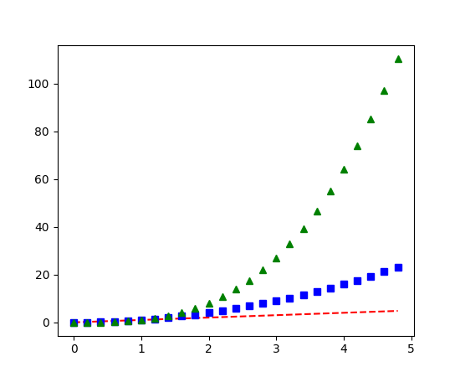
Formating style of plot
©2021 Proprietary and Confidential. All Rights Reserved.
16

Slide 17
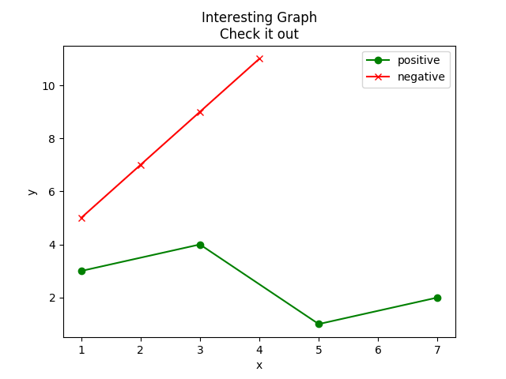
Legends, Titles, and Labels
©2021 Proprietary and Confidential. All Rights Reserved.
17

Slide 18
Visualizations

Slide 19
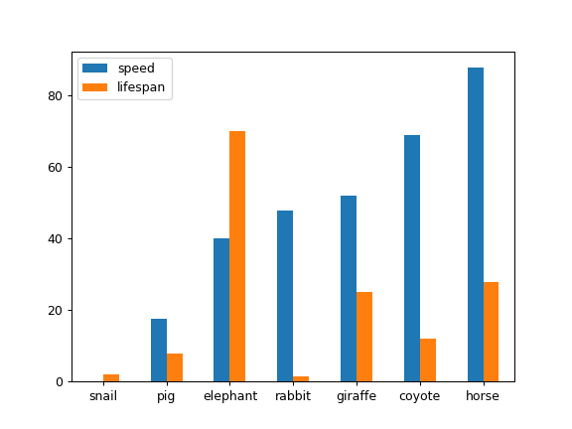
Bar Charts
plt.bar()
©2021 Proprietary and Confidential. All Rights Reserved.
19

Slide 20
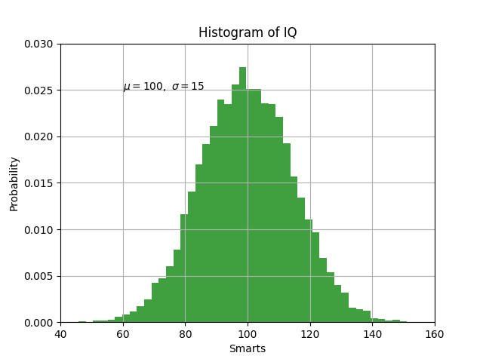
Histograms
plt.hist()
©2021 Proprietary and Confidential. All Rights Reserved.
20

Slide 21
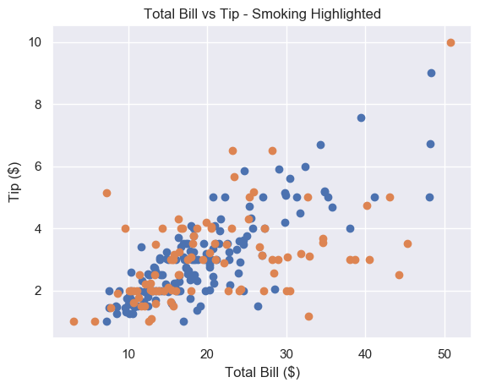
Scatter Plots
plt.scatter()
©2021 Proprietary and Confidential. All Rights Reserved.
21

Slide 22
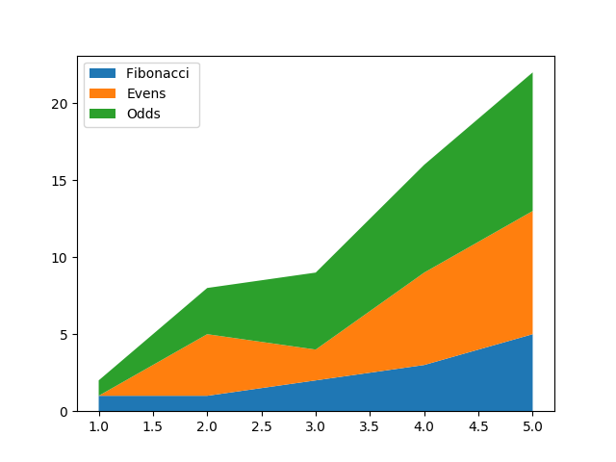
Stack Plots
plt.stackplot()
©2021 Proprietary and Confidential. All Rights Reserved.
22

Slide 23
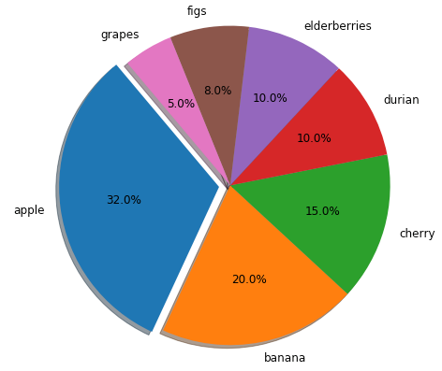
Pie Charts
plt.pie()
©2021 Proprietary and Confidential. All Rights Reserved.
23

Slide 24
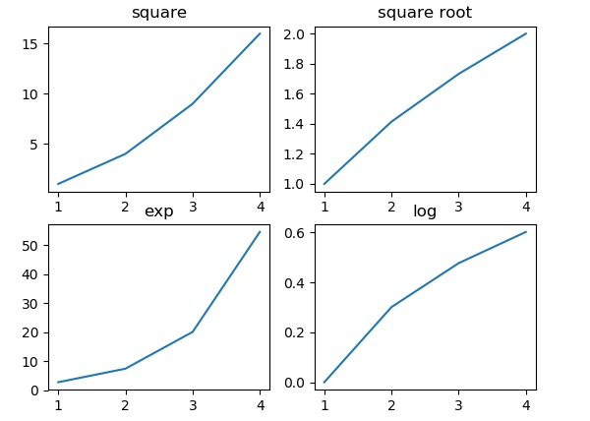
Matplotlib - Subplots() Function
plt.subplot()
©2021 Proprietary and Confidential. All Rights Reserved.
24

Slide 25
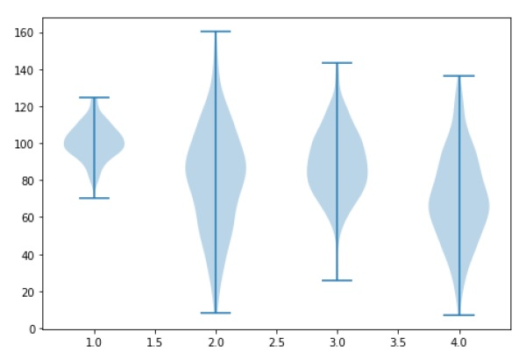
Violin Plot
ax.violionplot()
©2021 Proprietary and Confidential. All Rights Reserved.
25

Slide 26
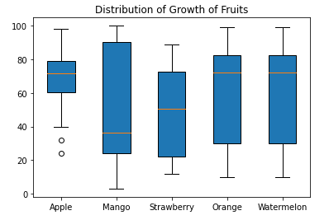
Box Plot
ax.boxplot()
©2021 Proprietary and Confidential. All Rights Reserved.
26

Slide 27
Backends.

Slide 28
What is a backend?
To support variety of use cases, Matplotlib can target different outputs, and each of these capabilities is called a backend.
The “frontend” is the user facing code, i.e., the plotting code, whereas the “backend” does all the hard work behind-the-scenes to make the figure.
©2021 Proprietary and Confidential. All Rights Reserved.
28

Slide 29
Types of backends
User interface backends
Hardcopy backends
For use in PyQt/PySide, PyGObject, Tkinter, wxPython, or macOS/Cocoa.
Also called, interactive backends.
To make image files such as PNG, SVG, PDF, PS.
Also called, non-interactive backends.
©2021 Proprietary and Confidential. All Rights Reserved.
29

Slide 30
Selecting a backend
Setting rcParams[“backend”] in your matplotlibrc file
If your script depends on a specific backend
Setting the MPLBACKEND environment variable
backend : qt5agg
import matplotlib
matplotlib.use('qt5agg')
> set MPLBACKEND=qt5agg
> python simple_plot.py
©2021 Proprietary and Confidential. All Rights Reserved.
30

Slide 31
Additional Resources

Slide 32
Class Notebooks
https://github.com/Africa-Data-School/ADS_Course_Material
Matplotib Documentation
https://matplotlib.org/stable/contents.html
©2021 Proprietary and Confidential. All Rights Reserved.
32

